Slide 1
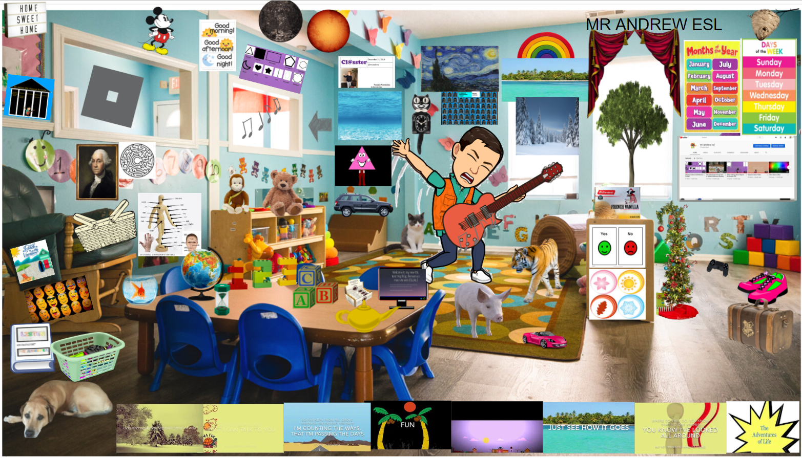
Mr Andrew ESL Bitmoji Classroom - Google Slides

Slide 2
Songs
1-Intro Music
2-Yes/No
3-Good Morning
4-Rain or the Sun
5-Colors 6-January
7-Monday 8-Seasons
9-Meditation Spa Music
10-Active walk
11-traveling
12-Don’t Waste the Day 1
13-Don’t Waste the Day 2
14-Don’t Waste the Day 3
15-What Hurts?
16-Vacation (The 5 Ws)
17-Get Dressed
18-I Really Want a Dog
19-The ocean 20-the jungle
21-The farm 22-The forest
23-Shapes 24-Left-Right
25-12345 26-Friends
27-Places I lose things
28-Space 29-Getting there
30-See the world 31-ABC
32-So far away 33-Town
34-See how it goes
35-Quarantime Part 1
36 Quarantime Part 2
37-Fun 38-Christmas
39-I’ve got to go
40-The House
41-Hourglass Spa Music
40
50
55
9
49
3
28
5
5
39
23
44
6
7
62
9
63
59
19
48
61
22
13
24
14
53
60
64
44
15
46
65
1
51
47
1
54
52
2
30
20
12
16
25
31
58
8
38
45
41
42
21
10
26
43
11
57
29
17
18
36
35
32
37
33
34
27
56
The Adventures of Life Stories: 42-Going Potty 43-They Really Want a Dog 44-Family Movie Night 45-Whale Watching 46-My Great Grandmother’s Monkey 47-Going home from Daycare
48-Calvin’s Mixed-up Schedule Pt.2 49-Mickey is Sick 50-Space has changed 51-Calvin’s Mixed-up schedule Pt.1 52-My new Cats 53-The Days of the Week 54-The Weather 55-The Exterminator
56-Playlist
Extra Videos: 57-Activity Book 58-Web Site 59-Roblox 60-Space Game 61-Games 62-Calvin’s song/Classter 63-Mr Andrew ESL Program Video 64-Youtube Page 65-Goldilocks and the 3 Bears

Slide 3
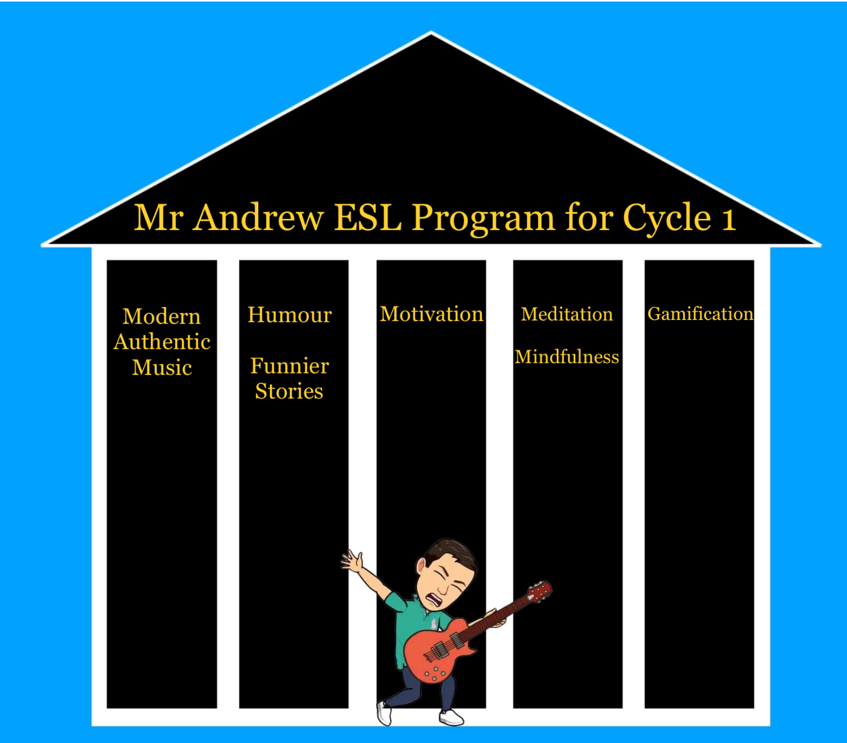

Slide 4

Today’s Menu
Do a typical Mr Andrew ESL Lesson…
Except occasionally « Break the 4th Wall », like I’m doing here…to explain things..
1-Lead in with my relaxing Spa music (check)
2-Greet fake students individually (check)
3-Play motivational video
4-Show you the Bitmoji Classroom (check)
5-Talk about the five pillars to my program (check)
6-At this point we’re probably here…
7-Show you my songs and then talk about them
*7.5-Pretend too many people are talking so that I can put on my Hourglass tool
8-Show you my story videos that go with the songs
9-Play games and talk about my games
10-Do Revision of target vocabulary
11-Cooldown/Fabulous Prizes

Slide 5
Authentic Music: My Songs
Separated into « Seasons »
Season 1: Basics of English
Season 2 (Grade 1): Feelings
Seasons 2 (Grade 2): Places

Slide 6
Nursery
Rhymes
Better Songs
Some Do It
Many Don’t Want to Do it
Most Will Do It
You feel
great
Because they like it
Because you are asking them to
Threaten them into singing
They will love English
You are tired
Calling and meeting with parents
Principal
Meeting with teachers
Agenda
Messages
They do it

Slide 7
Meditation
Spa Music Video
Hourglass/Spa Music Timer

Slide 8
Humour in Teaching
Stories: The Adventures of Life
Stories from my life, that complement the songs

Slide 9
Gamification
Roblox Games that complement the songs and stories
Google Slides « Escape Games », Match Games and Mazes,
Social Media Style « Cl@sster » to practice writing
Virtual Classroom with interactive icons
Classroom Management Point system done in the same way that video games do (points, common-ultra rare model)

Slide 10
Motivation
My program produces motivated learners.
They want to come to class.
They want to sing and dance.
They look forward to the next English Class.
They want to practice at home (playing the games, watching the videos, making the Cl@ssters).

